Slide 1
Google Data Analytics Capstone Project: Cyclistic
by: Caleb Mar

Slide 2



Contents
Business Task
Data Insights
Analysis of Data
Summary
Solutions

Slide 3
Business Task
Identify differences between casual riders and member riders?
Why would casual riders buy Cyclistic annual memberships?
What types of implementation will the company decide to use to increase the number of member riders?

Slide 4


Data Insights: Data used for Cyclistic
The source of my data comes from here.
The data I have downloaded are made available by Motivate International Inc under this license (Data License Agreement | Divvy Bikes)
Tools used for data cleaning and analysis: R Studio and Excel
Data measured from Quarter 2 of 2019 and Quarter 1 2020.
Data is split into each day of the week.

Slide 5
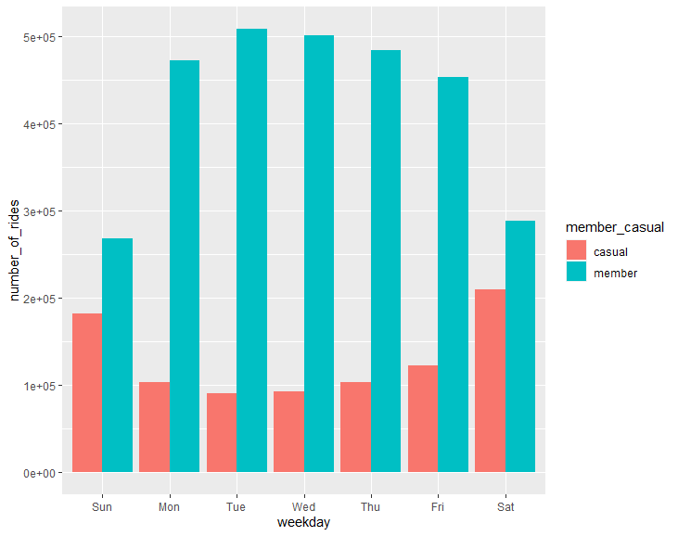
Analyzing the Data of Divvy Bikes
Number of Rides: Casual riders vs Annual Member riders throughout the week
Findings: Annual members are more likely to use Divvy Bikes more frequently per day than casual riders.
The number of rides is greater for members throughout all days of the week.
Casual riders use bikes on the weekends the most (Saturday and Sunday

Slide 6
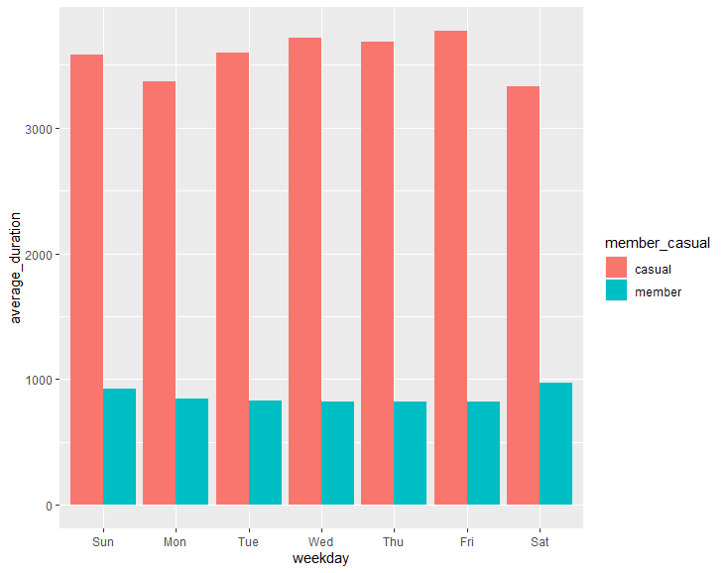
Analyzing the Data of Divvy Bikes (Cont.)
Total of Average Duration between Casual and Annual Members Per Day of the Week
Findings: I was surprised to find that casual riders average a greater duration every day of the week.
Casual rider’s total is almost three times greater than annual members riders.

Slide 7
Total Monthly Rides per Rider Type:
We can see both types of riders the bikes mostly through June to September
August is the peak month for both casual riders and annual members

Slide 8
Summary
Weekly:
Usage:
Monthly:
Casual riders use bikes for a longer average duration, however, annual members ride bikes more frequently and consistently.
Casual riders have almost 3x times the average duration than annual members use.
Bikes are used through June to September. The highest peak for casual and annual members in during August. However, casual riders are almost 3x less likely to ride the bikes frequently.

Slide 9
Possible Solutions: Casual and Annual Member Riders
We can:
Offer discounts and coupons based on duration of the ride. By doing so, customers will be encouraged to use bikes for longer, thus, increasing profits.
Since peak times are during the summer, it would be beneficial to create specific memberships that revolve around each of the seasons. This give customers who are do not want to commit to a yearly price to four month payments.
Advertise near the busiest location: Streeter Dr & Grand Ave, Lake Shore Dr & Monroe St, Millennium Park (see graph here)
Times for major promotions: June and July

Slide 10



THANK YOU!
Caleb Mar
caleb.mar102@gmail.com
linkedin.com/in/calebmar

Slide 11
Popular Stations for Casual Riders
Total Number of Rides

